Slide 1
ECE 532
CHAPTER 4: GRAPHS (PART 4: Shortest Path - Dijkstra’s algorithm)
Lecturer: Dr. Roslina Mohamad
Room: Tower 2, Level 13, No:14C

Slide 2
Learning Outcomes
In this chapter, you will:
Implement the shortest path algorithm

Slide 3
Paths
Routing problems – find an optimal path in a network
a shortest path in a graph/digraph
a cheapest path in a weighted graph/digraph
Example – a directed graph that models an airline network
vertices represent cities
direct arcs represent flights connecting cities
Task: find most direct route (least flights)

Slide 4
Paths
Most direct route equivalent to
finding length of shortest path
finding minimum number of arcs from start vertex to destination vertex
Search algorithm for this shortest path
an easy modification of the breadth-first search algorithm

Slide 5
Shortest Path Algorithm
Weight of the edge: nonnegative real number assigned to the edges connecting two vertices
Weighted graph: every edge has a nonnegative weight
Weight of the path P
Sum of the weights of all edges on the path P
Also called the weight of v from u via P
Source: starting vertex in the path

Slide 6
Shortest Path Algorithm
Shortest path: path with the smallest weight
Shortest path algorithm
Called the greedy algorithm, developed by Dijkstra
G: graph with n vertices, where n ≥ 0
V(G) = {v₁, v₂, ..., v_{n}}
W: two-dimensional n × n matrix

Slide 7
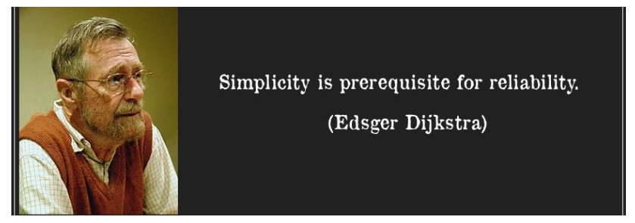
Edsger
Wybe
Dijkstra
May 11, 1930 – August 6, 2002
Dutch computer scientist from Netherlands
Received the 1972 A. M. Turing Award, widely considered the most prestigious award in computer science
Known for his many essays on programming

Slide 8
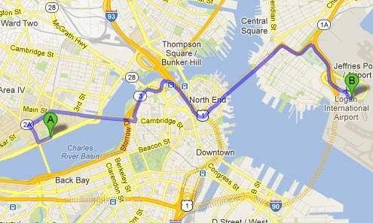
How do we get from 2-151 to Logan?

Slide 9
Applications
Shortest-paths is a broadly useful problem-solving model
• Maps
• Texture mapping.
• Urban traffic planning.
• Subroutine in advanced algorithms.
• Routing of telecommunications messages.
• Network routing protocols (OSPF, BGP, RIP).
• Optimal truck routing through given traffic congestion pattern.
Reference: Network Flows: Theory, Algorithms, and Applications, R. K. Ahuja, T. L. Magnanti, and J. B. Orlin, Prentice Hall, 1993.
•
•
•
•
•
•
Robot navigation.
Typesetting in TeX.
Optimal pipelining of VLSI chip.
Telemarketer operator scheduling.
Approximating piecewise linear functions.
Exploiting arbitrage opportunities in currency exchange.
7

Slide 10
Dijkstra’s Algorithm
finds the shortest path from the start vertex to every other vertex in the network. We will find the shortest path from A to G
B
4
F
4
1
2
4
7
D
A
7
3
2
3
G
E
2
C
5

Slide 11
Dijkstra’s Algorithm
1. Label the start vertex with permanent label 0 and order label 1
2 Assign temporary labels to all the vertices that can be reached directly from the start
3 Select the vertex with the smallest temporary label and make its label permanent. Add the correct order label.
4 Put temporary labels on each vertex that can be reached directly from the vertex you have just made permanent. The temporary label must be equal to the sum of the permanent label and the direct distance from it. If there is an existing temporary label at a vertex, it should be replaced only if the new sum is smaller.
5 Select the vertex with the smallest temporary label and make its label permanent. Add the correct order label.
6 Repeat until the finishing vertex has a permanent label.
7 To find the shortest paths(s), trace back from the end vertex to the start vertex. Write the route forwards and state the length.

Slide 12
Dijkstra’s
Algorithm
Order in which
vertices are
Distance from
A to vertex
labelled.
Working
B
4
F
1
0
4
1
2
4
7
D
A
Label vertex A
1 as it is the first vertex labelled
7
3
2
3
G
E
2
C
5

Slide 13
Dijkstra’s
Algorithm
We update each vertex adjacent to A
with a ‘working
value’
for
its
distance
from
A.
4
B
4
F
1
0
4
1
7
2
4
7
D
A
7
3
2
3
G
E
2
C
5
3

Slide 14
Dijkstra’s
Algorithm
4
B
4
F
1
0
4
1
7
2
4
7
D
A
7
3
2
3
G
Vertex C is closest
to A so we give it a permanent label 3.
E
2
C
5
2
3
C is the
2nd
vertex to
3
be permanently
labelled.

Slide 15
Dijkstra’s
Algorithm
We update each vertex adjacent to C with a
‘working value’ for its total distance from A, by
adding its distance from C
to
C’s
permanent
label
of
3.
4
B
4
6 < 7 so replace the
F
4
t-label here
1
0
1
2
7 6
4
7
D
A
7
3
2
3
G
E
2
C
5
2
3
3
8

Slide 16
Dijkstra’s
Algorithm
The vertex with the
smallest temporary label is
B, so make this label
3
4
permanent. B is the
3rd
4
vertex to be permanently
labelled.
4
B
F
1
0
4
1
7 6
2
4
7
D
A
7
3
2
3
G
E
2
C
5
2
3
3
8

Slide 17
Dijkstra’s
Algorithm
We update each vertex adjacent to B with a
‘working value’ for its total distance from A, by
adding its distance from B
to
B’s
permanent
3
4
label
of
4.
4
B
4
5 < 6 so replace the
8
F
4
t-label here
1
0
1
2
7 6 5
4
7
D
A
7
3
2
3
G
E
2
C
5
2
3
3
8

Slide 18
Dijkstra’s
Algorithm
The vertex with the smallest
temporary label is D, so
make this label permanent. D
3
4
is the
4th
vertex to be
4
permanently labelled.
4
B
8
F
1
0
4
4
5
1
7 6 5
2
4
7
D
A
7
3
2
3
G
E
2
C
5
2
3
3
8

Slide 19
Dijkstra’s
Algorithm
We update each vertex adjacent to D with a
‘working value’ for its total distance from A, by
adding its distance
from D
to
D’s
permanent
3
4
label
of
5.
4
B
4
8 7
F
4
4
5
7 < 8 so replace the t-label here
1
0
1
7 6 5
2
4
7
D
A
7
3
2
3
7 < 8 so replace the t-label here
G
E
2
C
5
12
2
3
3
8 7

Slide 20
Dijkstra’s
Algorithm
3
4
4
B
4
8 7
F
1
0
4
4
5
1
7 6 5
2
4
7
D
A
7
3
2
3
G
E
2
C
5
12
2
3
5
7
3
8 7
The
vertices with the smallest
temporary labels are E and F, so
choose one and make the label
permanent. E is chosen - the
5th
vertex to be permanently labelled.

Slide 21
Dijkstra’s
Algorithm
We update each vertex adjacent to E with a
‘working value’ for its total distance from A, by
adding its distance
from E
to
E’s
permanent
3
4
label
of
7.
4
B
4
8 7
F
1
0
4
4
5
1
7 6 5
2
4
7
D
A
7
3
2
3
G
E
2
C
5
12
5
7
9
2
3
3
8 7
9 < 12 so replace the t-label here

Slide 22
Dijkstra’s
Algorithm
The vertex with the smallest
temporary label is F, so make this label permanent.F is the
6th
vertex to be permanently
3
4
labelled.
4
6
7
B
4
8 7
F
1
0
4
4
5
1
7 6 5
2
4
7
D
A
7
3
2
3
G
E
2
C
5
12
5
7
9
2
3
3
8 7

Slide 23
Dijkstra’s
Algorithm
We update each vertex adjacent to F with a
‘working value’ for its total
distance from A, by
adding its distance
from F
to
F’s
permanent
3
4
label
of
7.
4
6
7
B
4
8 7
F
1
0
4
4
5
1
7 6 5
2
4
7
D
A
7
3
2
3
G
E
2
C
5
12
5
7
9
2
3
3
8 7
11 > 9 so
replace the t-label here
do not

Slide 24
Dijkstra’s
Algorithm
3
4
4
6
7
B
4
8 7
F
1
0
4
4
5
1
7 6 5
2
4
7
D
A
7
3
2
3
G
2
7
9
C
5
E
12
5
7
9
2
3
3
8 7
G is the final vertex
to be permanently labelled.

Slide 25
Dijkstra’s
Algorithm
To find the shortest path from A to G, start
from G and work backwards, choosing arcs for which the difference between the permanent
3
4
labels
is
equal
to
the
arc
length.
4
6
7
B
4
8 7
F
1
0
4
4
5
1
7 6 5
2
4
7
D
A
7
3
2
3
G
2
7
9
C
5
E
12
5
7
9
2
3
3
8 7
The
shortest path is ABDEG,
with
length 9.

Slide 26
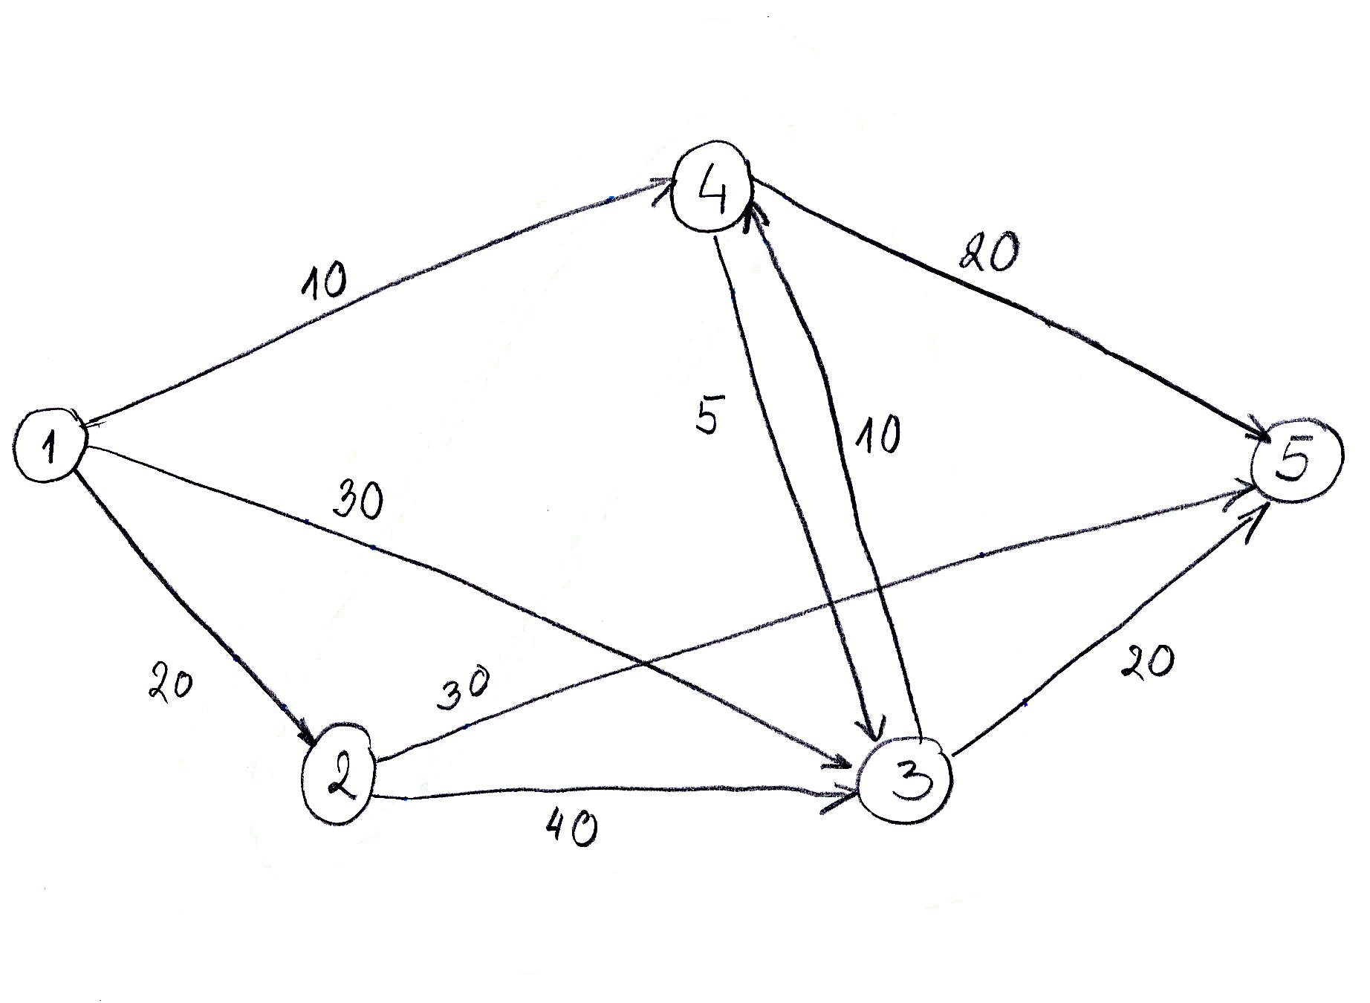
One-To-All Shortest Path Problem
We are given a weighted network (V, E, C ) with node set V , edge set E,
and the weight set C specifying weights
cij
for the edges ^{(i, j)} ∈ ^{E}. We are
also given a starting node ^{s} ∈ ^{V} . The one-to-all shortest path problem is
the problem
of determining
network.
the
shortest
path
from
node
s
to
all
the
other
nodes
in
the
The weights
on the links
are also referred as costs.

Slide 27
Notation
In what follows:
• d_{f} denotes the distance value of a node f.
• ^{p} or
t denotes the status label of a node, where p stand for permanent
and t stands for temporary
•
cij
is the cost of traversing link (i, j) as given by the problem
The state of a node
status label.
f is the ordered pair of its distance value
df
and its

Slide 28
Algorithm Steps
Step 1. Initialization
• Assign the
[The state
• Assign to
zero distance value to node s, and label it as Permanent.
of node s is (0, p).]
every node a distance value of ∞ and label
them
as
Temporary. [The state of every other node is ⁽∞^{, t)}.]
• Designate
the
node
s
as
the
current node

Slide 29
Step 2.
Distance Value Update and Current Node Designation Update
Let i be the index of the current node.
(1)
Find the
from the
of these
set J of nodes with temporary labels that can be reached
current node
nodes.
i by a link (i, j). Update the distance values
• For each
^{j} ∈ ^{J} , the
distance value dj of node j is updated as follows
new
^{d}j ^{= min}{^{d}j ^{, d}i ^{+ c}ij }
where
cij
is the
cost of link (i, j), as given in the network problem.
(2)
Determine a node
nodes j ∈ J ,
j that has the smallest distance value dj among
all
find
j∗
such that
min d_{j} =
^{j}∈^{J}
dj∗
(3)
Change the label of node
the current node.
j∗
to permanent and designate this node
as

Slide 30
Step 3. Termination Criterion
If all nodes that can be reached from node s have been permanently labeled, then stop - we are done.
If we cannot reach any temporary labeled node from
the
are
current
done.
node,
then all the temporary labels
become
permanent
-
we
Otherwise,
go
to
Step
2.

Slide 31
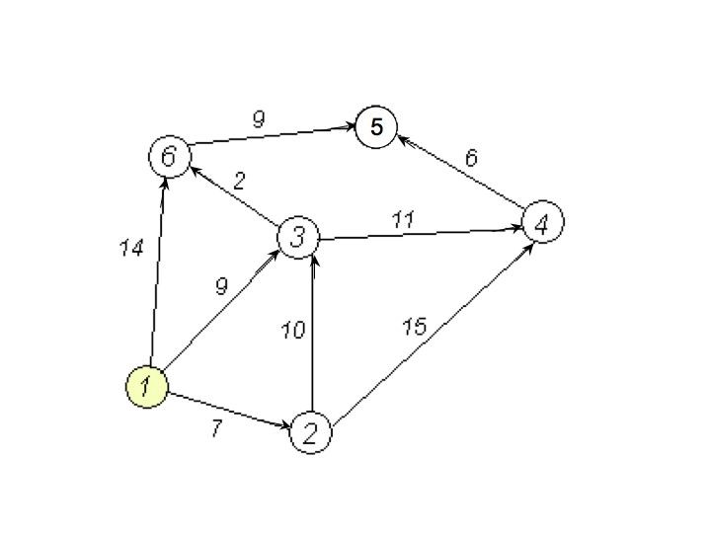
Dijkstra’s
Algorithm:
Example
We want to find the shortest path from node 1 to
Dijkstra’s algorithm.
all other nodes using

Slide 32
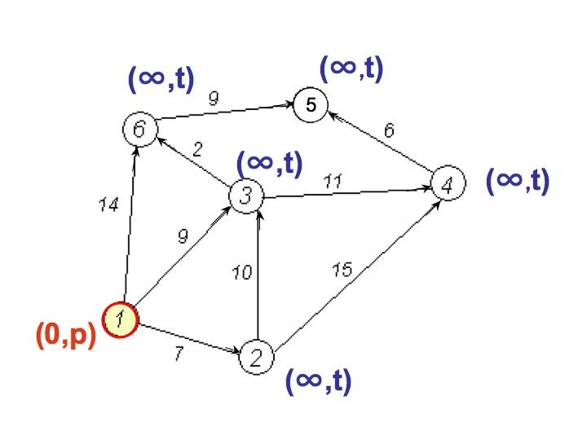
Initialization
-
Step
1
• Node 1 is designated as the current
node
• The state of node 1 is ^{(0, p)}
• Every
other
node
has
state
⁽∞^{, t)}

Slide 33
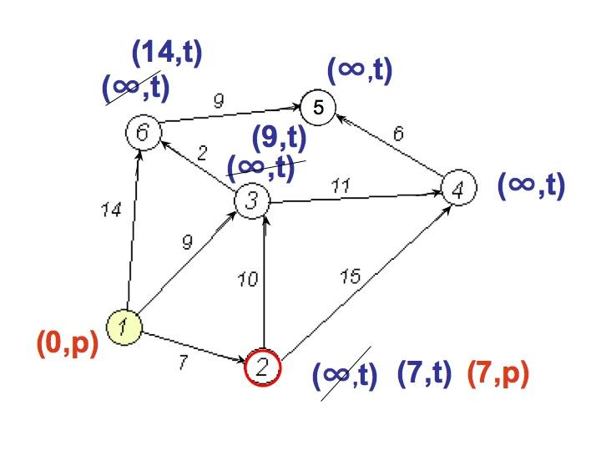
Step
• Nodes 2, 3,and 6 can be reached
from the current node 1
2
• Update distance values
nodes
for these
d2 =
d₃ =
d₆ =
^{min}{∞^{, 0 + 7}}
min{∞, 0 + 9}
= 7
= 9
^{min}{∞^{, 0 + 14}} ⁼ ¹⁴
• Now, among the nodes 2, 3, and
value
6, node
2 has the smallest distance
• The status label of node 2 changes
to permanent, so its state is (7, p),
temporary
while the status of 3
and 6 remains
• Node 2 becomes the
current node

Slide 34
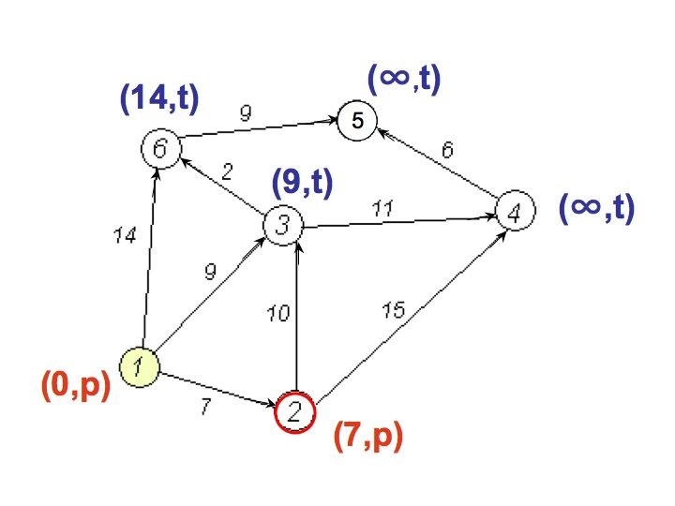
Step
3
Graph
at
the
end
of
Step
2
We are not done, not all nodes have
been
reached from node 1, so we
perform another iteration (back to Step 2)

Slide 35
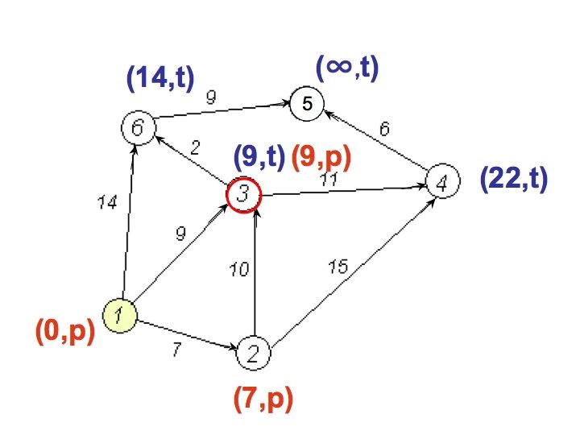
Another
Implementation
of
Step
2
• Nodes
3 and
4
can
node
be
2
reached
from the current
• Update distance
nodes
values for these
^{d}3 ^{= min}{^{9, 7 + 10}} ⁼ ⁹
d6 = min{∞, 7 + 15} = 22
• Now, between the nodes 3 and 4 node
• The status label of node 3 changes to remains temporary
• Node 3 becomes the current node
3 has the smallest
permanent, while
distance value
the status of 6
We are not done (Step 3 fails), so we perform another Step
2

Slide 36
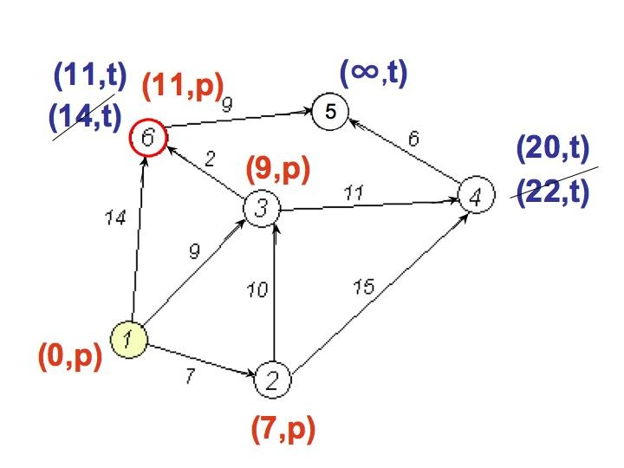
Another
Step
2
• Nodes
6 and
4 can be
reached
from the current node 3
• Update distance values for them
^{d}4 ^{= min}{^{22, 9 + 11}} ⁼ ²⁰
^{d}6 ^{= min}{^{14, 9 + 2}}
= 11
• Now, between the nodes
• The status label of node remains temporary
6 and 4 node
6 changes to
6 has
the smallest distance value
permanent, while
the status of 4
• Node 6 becomes the current node
We are not done (Step 3 fails), so we perform another Step
2

Slide 37
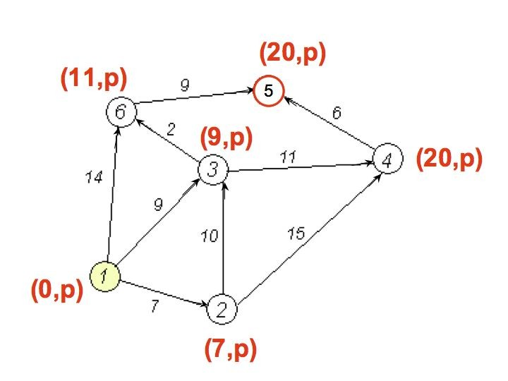
Another
Step
2
• Node 5 can be reached from the
current node 6
• Update distance value for node 5
^{d}5 ^{= min}{∞^{, 11 + 9}} ⁼ ²⁰
• Now, node 5 is the only candidate,
so its
status
changes to permanent
• Node 5 becomes the current node
From node 5 we cannot reach any permanently labeled and we are done.
other
node.
Hence,
node 4 gets

Slide 38
Dijkstra's Shortest Path Algorithm
Find shortest path from s to t.
2
24
3
9
s
18
14
6
6
2
30
4
19
11
15
5
5
6
20
16
7
t
44

Slide 39
Dijkstra's Shortest Path Algorithm
S = { }
PQ = { s, 2, 3, 4, 5, 6, 7, t }
∞
∞
2
24
3
0
9
s
∞
18
14
6
6
2
∞
30
∞
4
19
11
15
5
5
6
20
16
7
t
44
distance label
∞
∞

Slide 40
Dijkstra's Shortest Path Algorithm
S = { }
PQ = { s, 2, 3, 4, 5, 6, 7, t }
delmin
∞
∞
2
24
3
0
9
s
∞
18
14
6
6
2
∞
30
∞
4
19
11
15
5
5
6
20
16
7
t
44
distance label
∞
∞

Slide 41
Dijkstra's Shortest Path Algorithm
S = { s }
PQ = { 2, 3, 4, 5, 6, 7, t }
decrease key
∞
∞
9
X
2
24
3
0
9
s
∞
14
18
14
X
6
6
2
∞
30
∞
4
19
11
15
5
5
6
20
16
7
t
44
distance label
∞
15
∞
X

Slide 42
Dijkstra's Shortest Path Algorithm
S = { s }
PQ = { 2, 3, 4, 5, 6, 7, t }
delmin
∞
∞
9
X
2
24
3
0
9
s
∞
14
18
14
X
6
6
2
∞
30
∞
4
19
11
15
5
5
6
20
16
7
t
44
distance label
∞
15
∞
X

Slide 43
Dijkstra's Shortest Path Algorithm
S = { s, 2 }
PQ = { 3, 4, 5, 6, 7, t }
∞
∞
9
X
2
24
3
0
9
s
∞
14
18
14
X
6
6
2
∞
30
∞
4
19
11
15
5
5
6
20
16
7
t
44
∞
15
∞
X

Slide 44
Dijkstra's Shortest Path Algorithm
S = { s, 2 }
PQ = { 3, 4, 5, 6, 7, t }
decrease key
∞
33
∞
X
9
X
2
24
3
0
9
s
∞
14
18
14
X
6
6
2
∞
30
∞
4
19
11
15
5
5
6
20
16
7
t
44
∞
15
∞
X

Slide 45
Dijkstra's Shortest Path Algorithm
S = { s, 2 }
PQ = { 3, 4, 5, 6, 7, t }
∞
33
∞
X
9
X
2
24
3
0
9
delmin
s
∞
14
18
14
X
6
6
2
∞
30
∞
4
19
11
15
5
5
6
20
16
7
t
44
∞
15
∞
X

Slide 46
Dijkstra's Shortest Path Algorithm
S = { s, 2, 6 }
PQ = { 3, 4, 5, 7, t }
32
∞
33
∞
X
X
9
X
2
24
3
0
9
s
∞
14
18
14
X
6
6
2
44
∞
∞
4
30
X
19
11
15
5
5
6
20
16
7
t
44
∞
15
∞
X

Slide 47
Dijkstra's Shortest Path Algorithm
S = { s, 2, 6 }
PQ = { 3, 4, 5, 7, t }
32
∞
33
∞
X
X
9
X
2
24
3
0
9
s
∞
14
18
14
X
6
6
2
44
∞
∞
4
30
X
19
11
15
5
5
6
20
16
7
t
44
∞
15
delmin
∞
X

Slide 48
Dijkstra's Shortest Path Algorithm
S = { s, 2, 6, 7 }
PQ = { 3, 4, 5, t }
32
∞
33
∞
X
X
9
X
2
24
3
0
9
s
∞
14
18
14
X
6
6
2
44
35
∞
X
∞
4
30
X
19
11
15
5
5
6
20
16
7
t
44
59
∞
∞
15
X
X

Slide 49
Dijkstra's Shortest Path Algorithm
S = { s, 2, 6, 7 }
PQ = { 3, 4, 5, t }
delmin
32
∞
33
∞
X
X
9
X
2
24
3
0
9
s
∞
14
18
14
X
6
6
2
44
35
∞
X
∞
4
30
X
19
11
15
5
5
6
20
16
7
t
44
59
∞
∞
15
X
X

Slide 50
Dijkstra's Shortest Path Algorithm
S = { s, 2, 3, 6, 7 }
PQ = { 4, 5, t }
32
∞
33
∞
X
X
9
X
2
24
3
0
9
s
∞
14
18
14
X
6
6
2
44
35
34
∞
X
X
∞
4
30
X
19
11
15
5
5
6
20
16
7
t
44
51
59
∞
∞
15
X
X
X

Slide 51
Dijkstra's Shortest Path Algorithm
S = { s, 2, 3, 6, 7 }
PQ = { 4, 5, t }
32
∞
33
∞
X
X
9
X
2
24
3
0
9
s
∞
14
18
14
X
6
6
2
44
35
34
∞
X
X
∞
4
30
X
19
11
15
5
5
6
20
delmin
16
7
t
44
51
59
∞
∞
15
X
X
X

Slide 52
Dijkstra's Shortest Path Algorithm
S = { s, 2, 3, 5, 6, 7 }
PQ = { 4, t }
32
∞
33
∞
X
X
9
X
2
24
3
0
9
s
∞
14
18
14
X
6
6
2
35
34
45
∞
44
X
X
X
∞
4
30
X
19
11
15
5
5
6
20
16
7
t
44
50
51
59
∞
∞
15
X
X
X
X

Slide 53
Dijkstra's Shortest Path Algorithm
S = { s, 2, 3, 5, 6, 7 }
PQ = { 4, t }
32
∞
33
∞
X
X
9
X
2
24
3
0
9
s
∞
14
18
14
X
6
6
2
35
34
45
∞
44
X
X
X
∞
4
30
X
19
11
15
5
delmin
5
6
20
16
7
t
44
50
51
59
∞
∞
15
X
X
X
X

Slide 54
Dijkstra's Shortest Path Algorithm
S = { s, 2, 3, 4, 5, 6, 7 }
PQ = { t }
32
∞
33
∞
X
X
9
X
2
24
3
0
9
s
∞
14
18
14
X
6
6
2
35
34
45
∞
44
X
X
X
∞
4
30
X
19
11
15
5
5
6
20
16
7
t
44
50
51
59
∞
∞
15
X
X
X
X

Slide 55
Dijkstra's Shortest Path Algorithm
S = { s, 2, 3, 4, 5, 6, 7 }
PQ = { t }
32
∞
33
∞
X
X
9
X
2
24
3
0
9
s
∞
14
18
14
X
6
6
2
35
34
45
∞
44
X
X
X
∞
4
30
X
19
11
15
5
5
6
20
16
7
t
44
delmin
50
51
59
∞
∞
15
X
X
X
X

Slide 56
Dijkstra's Shortest Path Algorithm
S = { s, 2, 3, 4, 5, 6, 7, t }
PQ = { }
32
∞
33
∞
X
X
9
X
2
24
3
0
9
s
∞
14
18
14
X
6
6
2
35
34
45
∞
44
X
X
X
∞
4
30
X
19
11
15
5
5
6
20
16
7
t
44
50
51
59
∞
∞
15
X
X
X
X

Slide 57
Dijkstra's Shortest Path Algorithm
S = { s, 2, 3, 4, 5, 6, 7, t }
PQ = { }
32
∞
33
∞
X
X
9
X
2
24
3
0
9
s
∞
14
18
14
X
6
6
2
35
34
45
∞
44
X
X
X
∞
4
30
X
19
11
15
5
5
6
20
16
7
t
44
50
51
59
∞
∞
15
X
X
X
X

Slide 58
Dijkstra’s Label Setting Algorithm
Dijkstra (weighted simple digraph, vertex first)
for all vertices v
currDist(v) = ∞;
currDist(first) = 0;
tobeChecked = all vertices;
while tobeChecked is not empty
v = a vertex in tobeChecked with minimal currDist(v);
remove v from tobeChecked;
for all vertices u adjacent to v and in tobeChecked
if currDist(u) > currDist(v) + weight(edge(vu))
currDist(u) = currDist(v) + weight(edge(vu));
predecessor(u) = v;

Slide 59
Example
C
E
3
4
A
4
2
3
1
D
2
B
3
F
5
3
1
1
G
2
H

Slide 60
Example
Initially the currDist(v) for every vertex in the graph is set to ∞.
Next the currDist(start) is set to 0, where start is the initial node for the path (start is D)
C
4
E
A
3
4
2
3
1
D
2
B
3
F
5
3
1
1
G
2
H

Slide 61
Technique
The first iteration of the algorithm will remove the vertex with the minimum currDist( ) which will be vertex D and then set the currDist( ) for every vertex which is both adjacent to D and in tobeChecked
C
4
E
A
3
4
2
3
1
B
3
D
2
F
5
3
1
1
G
2
H

Slide 62
Example
The second iteration will again selected the minimum value of currDist( ) from the vertices in tobeChecked, So vertex F is removed from the set tobeChecked and the active vertex is set to F
Change the value of E and H in CurDist
iteration | initial | 1 | 2
active vertex | − | D | F
A | ∞ | ∞ | ∞
B | ∞ | 3 | 3
C | ∞ | 4 | 4
D | 0
E | ∞ | ∞ | 3
F | ∞ | 2
G | ∞ | ∞ | ∞
H | ∞ | ∞ | 3
C
4
E
A
3
4
2
3
1
B
3
D
2
F
5
3
1
1
G
2
H

Slide 63
Example
The third iteration will select vertex B as it has the minimum weight for all of the vertices in tobeChecked( ). So the next active vertex becomes vertex B Change the value of G in CurDist
iteration | initial | 1 | 2 | 3
active vertex | − | D | F | B
A | ∞ | ∞ | ∞ | ∞
B | ∞ | 3 | 3
C | ∞ | 4 | 4 | 4
D | 0
E | ∞ | ∞ | 3 | 3
F | ∞ | 2
G | ∞ | ∞ | ∞ | 8
H | ∞ | ∞ | 3 | 3
C
4
E
A
3
4
2
3
1
B
3
D
2
F
5
3
1
1
G
2
H

Slide 64
Example
The fourth iteration will select vertex E as it has the minimum weight for all of the vertices in tobeChecked( ). So the next active vertex becomes vertex E.
iteration | initial | 1 | 2 | 3 | 4
active vertex | − | D | F | B | E
A | ∞ | ∞ | ∞ | ∞ | ∞
B | ∞ | 3 | 3
C | ∞ | 4 | 4 | 4 | 4
D | 0
E | ∞ | ∞ | 3 | 3
F | ∞ | 2
G | ∞ | ∞ | ∞ | 8 | 8
H | ∞ | ∞ | 3 | 3 | 3
C
4
E
A
3
4
2
3
1
B
3
D
2
F
5
3
1
1
G
2
H

Slide 65
Example
The fifth iteration will select vertex H as it has the minimum weight for all of the vertices in tobeChecked( ). So the next active vertex becomes vertex H. Change the value of G in CurDist
iteration | initial | 1 | 2 | 3 | 4 | 5
active vertex | − | D | F | B | E | H
A | ∞ | ∞ | ∞ | ∞ | ∞ | ∞
B | ∞ | 3 | 3
C | ∞ | 4 | 4 | 4 | 4 | 4
D | 0
E | ∞ | ∞ | 3 | 3
F | ∞ | 2
G | ∞ | ∞ | ∞ | 8 | 8 | 5
H | ∞ | ∞ | 3 | 3 | 3
C
4
E
A
3
4
2
3
1
B
3
D
2
F
5
3
1
1
G
2
H

Slide 66
Example
The sixth iteration will select vertex C as it has the minimum weight for all of the vertices in tobeChecked( ). So the next active vertex becomes vertex C. Change the value of A in CurDist
iteration | initial | 1 | 2 | 3 | 4 | 5 | 6
active vertex | − | D | F | B | E | H | C
A | ∞ | ∞ | ∞ | ∞ | ∞ | ∞ | 7
B | ∞ | 3 | 3
C | ∞ | 4 | 4 | 4 | 4 | 4
D | 0
E | ∞ | ∞ | 3 | 3
F | ∞ | 2
G | ∞ | ∞ | ∞ | 8 | 8 | 5 | 5
H | ∞ | ∞ | 3 | 3 | 3
C
4
E
A
3
4
2
3
1
B
3
D
2
F
5
3
1
1
G
2
H

Slide 67
Example
The seventh iteration will select vertex G as it has the minimum weight for all of the vertices in tobeChecked( ). So the next active vertex becomes vertex G.
iteration | initial | 1 | 2 | 3 | 4 | 5 | 6 | 7
active vertex | − | D | F | B | E | H | C | G
A | ∞ | ∞ | ∞ | ∞ | ∞ | ∞ | 7 | 7
B | ∞ | 3 | 3
C | ∞ | 4 | 4 | 4 | 4 | 4
D | 0
E | ∞ | ∞ | 3 | 3
F | ∞ | 2
G | ∞ | ∞ | ∞ | 8 | 8 | 5 | 5
H | ∞ | ∞ | 3 | 3 | 3
C
4
E
A
3
4
2
3
1
B
3
D
2
F
5
3
1
1
G
2
H

Slide 68
Example
iteration | initial | 1 | 2 | 3 | 4 | 5 | 6 | 7 | 8
active vertex | − | D | F | B | E | H | C | G | A
A | ∞ | ∞ | ∞ | ∞ | ∞ | ∞ | 7 | 7
B | ∞ | 3 | 3
C | ∞ | 4 | 4 | 4 | 4 | 4
D | 0
E | ∞ | ∞ | 3 | 3
F | ∞ | 2
G | ∞ | ∞ | ∞ | 8 | 8 | 5 | 5
H | ∞ | ∞ | 3 | 3 | 3
The last iteration will select vertex A as it has the minimum weight for all of the vertices in tobeChecked( ). So the last active vertex becomes vertex A.
C
4
E
A
3
4
2
3
1
B
3
D
2
F
5
3
1
1
G
2
H

Slide 69
Example
iteration | initial | 1 | 2 | 3 | 4 | 5 | 6 | 7 | 8
active vertex | − | D | F | B | E | H | C | G | A
A | ∞ | ∞ | ∞ | ∞ | ∞ | ∞ | 7 | 7
B | ∞ | 3 | 3
C | ∞ | 4 | 4 | 4 | 4 | 4
D | 0
E | ∞ | ∞ | 3 | 3
F | ∞ | 2
G | ∞ | ∞ | ∞ | 8 | 8 | 5 | 5
H | ∞ | ∞ | 3 | 3 | 3
Shortest paths from D are: to A = 7, to B = 3, to C = 4, to E = 3, to F = 2, to G = 5, and to H = 3.

Slide 70
Exercise
iteration | initial | 1 | 2 | 3 | 4 | 5 | 6
active vertex | −
a | 0
b | ∞
c | ∞
d | ∞
e | ∞
f | ∞
C
10
E
4
A
3
7
3
8
4
6
D
4
B
F
7

Slide 71
Exercise
First Iteration:
tobechecked = {b, c, d, e, f}
currDist(b) = currDist(a) + weight(edge(ab)) = 3
currDist(c) = currDist(a) + weight(edge(ac)) = 4
currDist(d) = currDist(d) + weight(edge(ad)) = 8
iteration | initial | 1
active vertex | − | a
a | 0
b | ∞ | 3
c | ∞ | 4
d | ∞ | 8
e | ∞ | ∞
f | ∞ | ∞
C
10
E
4
A
3
7
3
8
4
6
D
4
B
F
7

Slide 72
Exercise
Second Iteration:
tobechecked = {c, d, e, f}
Vertex b is selected as the active vertex since it has minimum distance
currDist(f) = currDist(b) + weight(edge(bf)) = 10
iteration | initial | 1 | 2
active vertex | − | a | b
a | 0
b | ∞ | 3
c | ∞ | 4 | 4
d | ∞ | 8 | 8
e | ∞ | ∞ | ∞
f | ∞ | ∞ | 10
C
10
E
4
A
3
7
3
8
4
6
D
4
B
F
7

Slide 73
Exercise
Third Iteration:
tobechecked = {d, e, f}
Vertex c is selected as the active vertex since it has minimal distance.
currDist(e) = currDist(c) + weight(edge(ce)) = 14
currDist(f) = currDist(c) + weight(edge(cf)) = 7 (change since less than current value)
iteration | initial | 1 | 2 | 3
active vertex | − | a | b | c
a | 0
b | ∞ | 3
c | ∞ | 4 | 4
d | ∞ | 8 | 8 | 8
e | ∞ | ∞ | ∞ | 14
f | ∞ | ∞ | 10 | 7
C
10
E
4
A
3
7
3
8
4
6
D
4
B
F
7

Slide 74
Exercise
Fourth Iteration:
The active vertex is selected to be d.
currDist(d) = currDist(f) + weight(edge(fe)) = 14 (no change = current value)
tobechecked = {d, e}
iteration | initial | 1 | 2 | 3 | 4
active vertex | − | a | b | c | f
a | 0
b | ∞ | 3
c | ∞ | 4 | 4
d | ∞ | 8 | 8 | 8 | 8
e | ∞ | ∞ | ∞ | 14 | 14
f | ∞ | ∞ | 10 | 7
C
10
E
4
A
3
7
3
8
4
6
D
4
B
F
7

Slide 75
Exercise
iteration | initial | 1 | 2 | 3 | 4 | 5
active vertex | − | a | b | c | f | d
a | 0
b | ∞ | 3
c | ∞ | 4 | 4
d | ∞ | 8 | 8 | 8 | 8
e | ∞ | ∞ | ∞ | 14 | 14 | 14
f | ∞ | ∞ | 10 | 7
Fifth Iteration:
The active vertex is selected to be: d No changes possible
tobechecked = {e}
C
10
E
4
A
3
7
3
8
4
6
D
4
B
F
7

Slide 76
Exercise
Last Iteration:
The active vertex is selected to be e (the only one left in the tobechecked set)
no changes are made as vertex e has no emanating edges
iteration | initial | 1 | 2 | 3 | 4 | 5 | 6
active vertex | − | a | b | c | f | d | e
a | 0
b | ∞ | 3
c | ∞ | 4 | 4
d | ∞ | 8 | 8 | 8 | 8
e | ∞ | ∞ | ∞ | 14 | 14 | 14
f | ∞ | ∞ | 10 | 7
C
10
E
4
A
3
7
3
8
4
6
D
4
B
F
7

Slide 77
Exercise
The final table now holds the minimum distance from node a to every other node in the graph. Thus the minimum distances for this graph are:
The shortest path from node a to node b is: 3
The shortest path from node a to node c is: 4
The shortest path from node a to node d is: 8
The shortest path from node a to node e is: 14
The shortest path from node a to node f is: 7
C
10
E
4
A
8
3
7
3
6
D
4
B
F
7

